Slide 1
Combinational Digital Circuit

Slide 2
Lecture 32 Multiplexers
Lecture delivered by:
Deepak V.

Slide 3
Objectives
At the end of this lecture, student will be able to:
Acquire the knowledge of Multiplexers
Describe De-Multiplexers

Slide 4
Topics
Multiplexers
De-Multiplexers

Slide 5
Multiplexers
A multiplexer is a combinational circuit that selects binary information from one of many input lines and directs it to a single output line
The selection of a particular input line is controlled by a set of selection lines
Normally, there are 2^{n} input lines and n selection lines whose bit combinations determine which input is selected
For example, a two-to-one-line multiplexer connects one of two 1-bit sources to a common destination

Slide 6
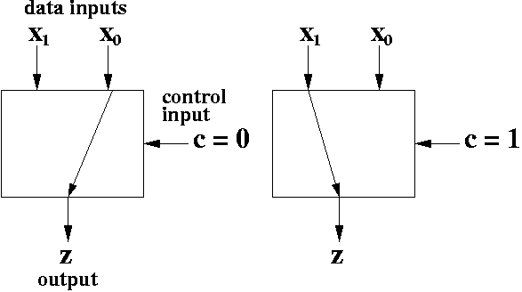
Multiplexers
In the figure below C is the select pin
X₁ ,X₀ are the input pins, Z is the output
When C=0, X₀ is chosen as output
When C=1, X₁ is chosen as output
Two to one Multiplexer

Slide 7
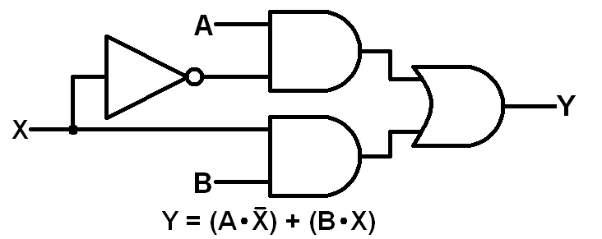
Multiplexers
The circuit diagram for a two to one MUX using logic gates is shown below:
2:1 MUX using basic gates

Slide 8
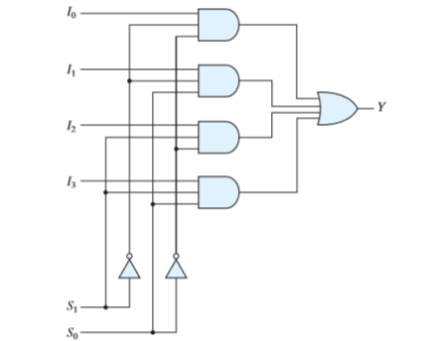
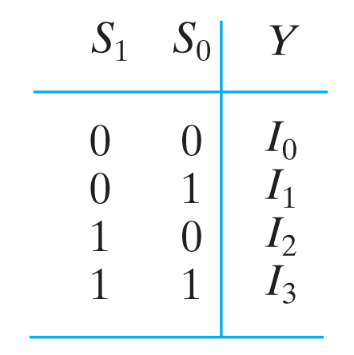
Multiplexers
A 4:1 MUX has 4 inputs, one output and two select lines
4:1 MUX using basic gates
4:1 MUX Truth table

Slide 9
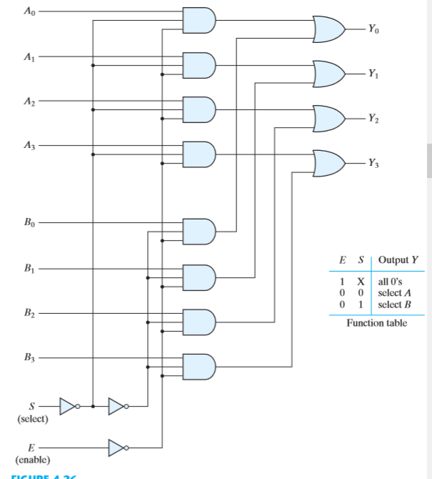
Multiplexers
Multiplexer circuits can be combined with common selection inputs to provide multiple-bit selection logic
As an illustration, a quadruple 2-to-1-line multiplexer is shown below
Quadruple two-to-one-line multiplexer

Slide 10
Multiplexers
A MUX can also be used to implement a Boolean function, the procedure is given below:
Implementing a Boolean function of n variables with a multiplexer that has n - 1 selection inputs:
The first n - 1 variables of the function are connected to the selection inputs of the multiplexer
The remaining single variable of the function is used for the data inputs
If the single variable is denoted by z, each data input of the multiplexer will be z, z’,1, or 0.

Slide 11
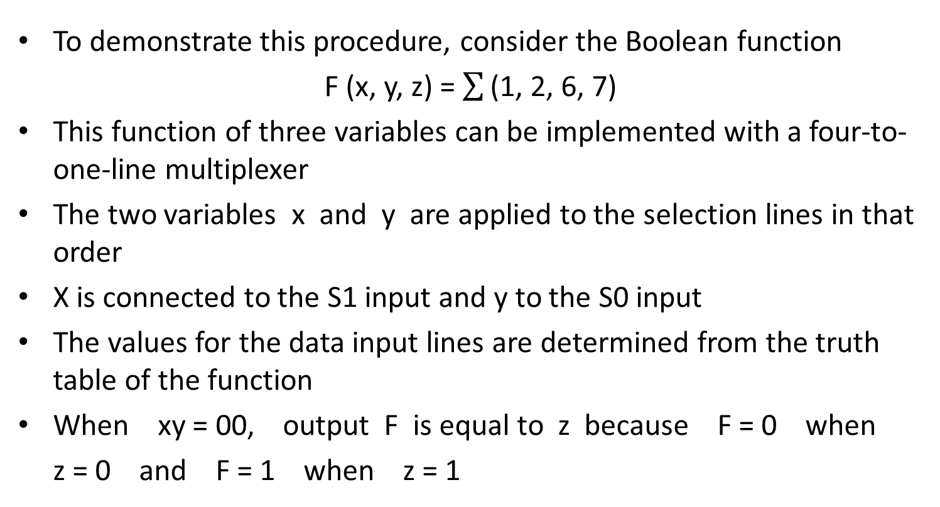
Multiplexers
To demonstrate this procedure, consider the Boolean function
F (x, y, z) = $\sum{\text{(1, 2, 6, 7)}}$
This function of three variables can be implemented with a four-to-one-line multiplexer
The two variables x and y are applied to the selection lines in that order
X is connected to the S1 input and y to the S0 input
The values for the data input lines are determined from the truth table of the function
When xy = 00, output F is equal to z because F = 0 when
z = 0 and F = 1 when z = 1

Slide 12
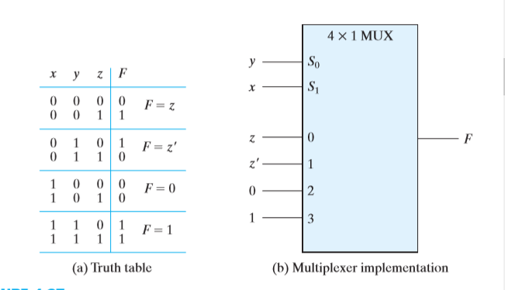
Multiplexers
Implementing a Boolean function with a multiplexer

Slide 13
Multiplexers
As a second example, consider the implementation of the Boolean function F (A, B, C, D) = Σ(1, 3, 4, 11, 12, 13, 14, 15)
This function is implemented with a multiplexer with three
selection inputs
A must be connected to selection input S2 so that A , B, and C correspond to selection inputs S2, S1, and S0, respectively

Slide 14
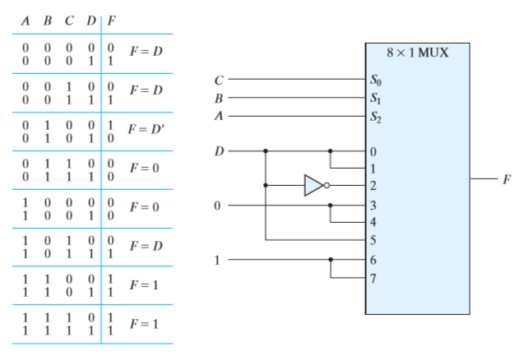
Multiplexers
Implementing a four-input function with a multiplexer

Slide 15
De-Multiplexers
A DEMUX is a digital switch with a single input (source) and a multiple outputs (destinations)
The select lines determine which output the input is connected to
DEMUX Types
→ 1-to-2 (1 select line)
→ 1-to-4 (2 select lines)
→ 1-to-8 (3 select lines)
→ 1-to-16 (4 select lines)

Slide 16
De-Multiplexers
A DEMUX has one input, 2^{n} outputs and n select lines
1
2^{N}
Input
(source)
DEMUX
Outputs
(destinations)
N
Select
Lines
De-Mux Block diagram

Slide 17
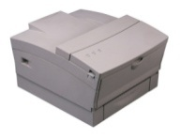

Typical Application of a DEMUX
De-Multiplexers
Single Source
Selector
Multiple Destinations
B/W Laser
Printer
Fax
Machine
D0
D1
D2
D3
X
DEMUX
Color Inkjet
Printer
B | A | Selected Destination
0 | 0 | B/W Laser Printer
0 | 1 | Fax Machine
1 | 0 | Color Inkjet Printer
1 | 1 | Pen Plotter
Pen
Plotter

Slide 18
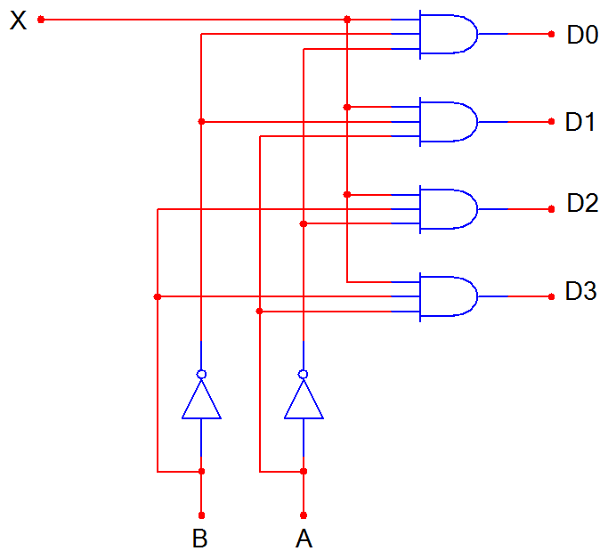
De-Multiplexers
D0
D1
D2
D3
X
DEMUX
B A
1:4 De-mux Block Diagram
B | A | D0 | D1 | D2 | D3
0 | 0 | X | 0 | 0 | 0
0 | 1 | 0 | X | 0 | 0
1 | 0 | 0 | 0 | X | 0
1 | 1 | 0 | 0 | 0 | X
1:4 De-mux Logic Diagram
1:4 De-mux Truth table

Slide 19
Summary
A multiplexer is a combinational circuit that selects binary information from one of many input lines and directs it to a single output line
Normally, there are 2^{n} input lines and n selection lines in a MUX whose bit combinations determine which input is selected
A DEMUX is a digital switch with a single input (source) and a multiple outputs (destinations)
A DEMUX has one input, 2^{n} outputs and n select lines

